Slide 1

Presentation of CS 410/CS 560
CS 410/CS 560: Software Engineering
Dr. Mohammed Ayoub Alaoui Mhamdi
Bishop's University
Sherbrooke, Qc, Canada
malaoui@ubishops.ca

Slide 2
Introduction
Professor: Dr. Mohammed Ayoub Alaoui Mhamdi
Email: malaoui@ubishops.ca
Office: HAM 161
Office hours: To be determined
Lectures:
  Monday and Wednesday 4:00 pm to 5:29 pm HAM 301
  Wednesday and Friday 8:30 pm to 9:59 pm BWH

Slide 3
Evaluation CS 560
Five assignments 40%
Final project 30%
Final exam 30%
Your attendance at the lectures is highly recommended.

Slide 4
Evaluation (cn’td)
The assignments can be done by groups of up to three students.
  Otherwise PENALTIES
The assignments’ submissions mut be performed through Moodle.
10 points per day late + 0 after 7 days late.
An error in submission on Moodle….
can lead to a score of 0.

Slide 5
Prerequisites
Programming language.

Slide 6
Recommandations
Do not wait until the last minute to do the assignments,
Do 100% of the assignments and not 33.3%-33.3%-33.3%,
Never a good idea to plagiarize,
Active participation in class,
Real time feedbacks.

Slide 7
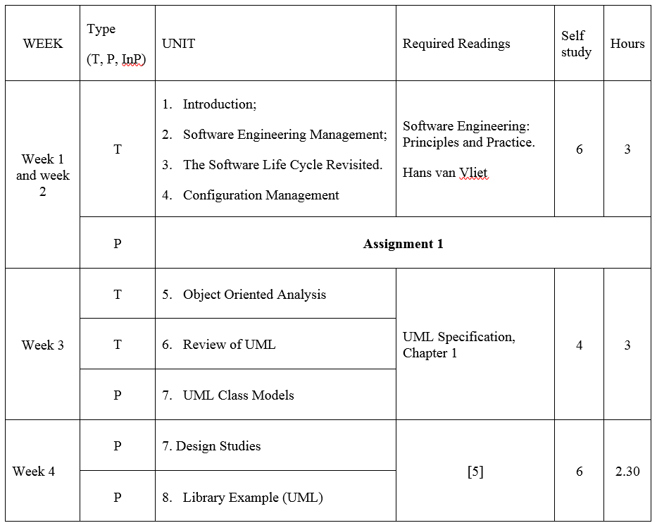
Course content and schedule

Slide 8
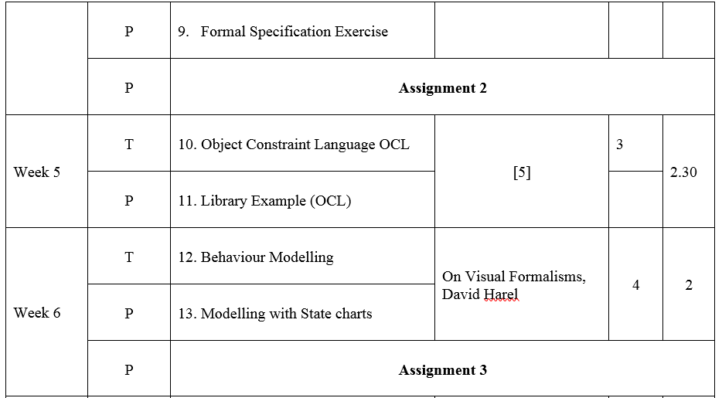
Course content and schedule

